Slide 1




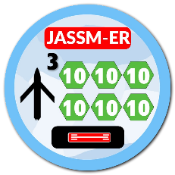
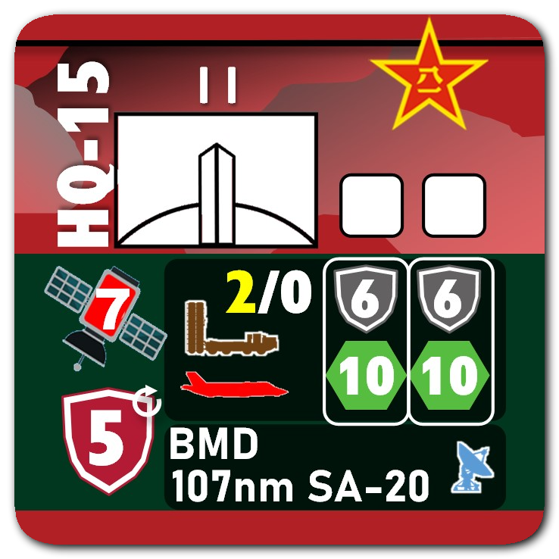
OCA #1
F-15EX can employ JASSM for this round. Notice the standard JASSM variant has only a range of ‘1’
Fighter Units can be designated as strike without a stand-off munitions token. When this is the case, fighter units may only attack one ground unit using its stated attack value and must be In-Hex.
Place a STRIKE marker on fighter units designated for strike missions during Air Tasking Order and Air Movement Phase.
Strikers are limited to self-defense In-Hex Air to Air Combat only
B-1B with a load-out of JASSM-ER available for Blue.
JASSM-ER and other stand-off munitions are non-renewable resources. Once used, the token is removed from game play.
Air Units and Munitions tokens must be collocated at the same air base to be loaded and employed.
Bombers must be loaded with a munition.
Note the weapon’s range on the token. JASSM-ER range of ‘3’
Stand-off muntions (cruise missiles) can be intercepted In-Hex only by:
Uncommited/non-engaged fighters may only engage 1 salvo.
(Use a defense value of 5 for JASSM)
Surface to Air Missile systems (Use grey shield value) not to exceed the total number of intercepts available per SAM unit.
Target type and range
This silhouette (a runway) indicates munitions are intended for ground domain targets. This includes all ground targets.

Slide 2
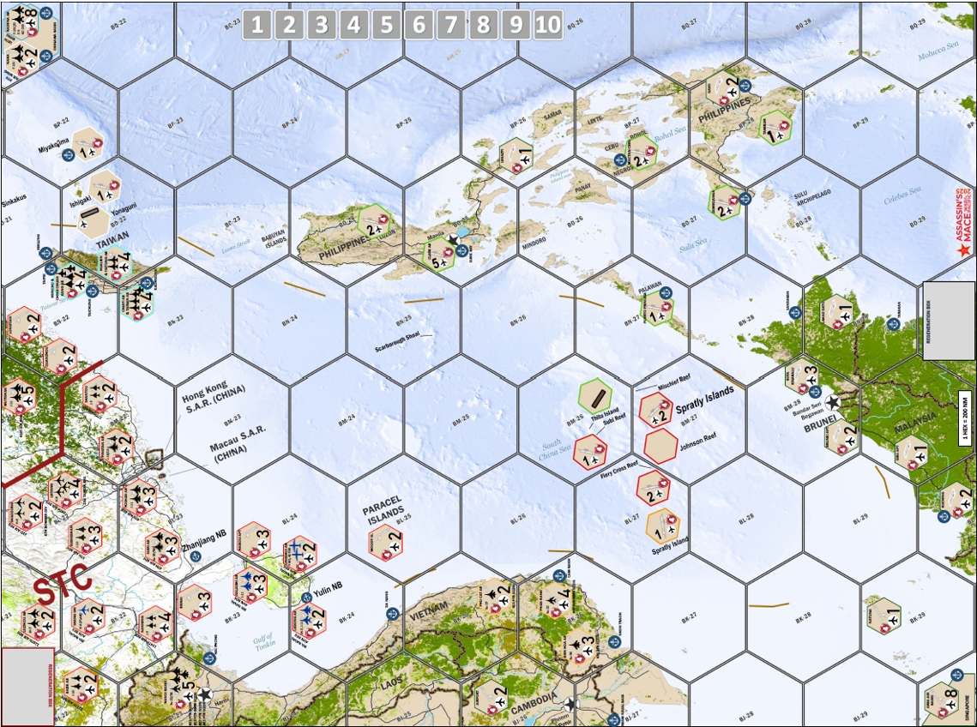
An airbase is limited on the number of squadrons it can support. Reference the large number within the airbase sub-hex.
Example: Mischief Reef is limited to 2 squadrons.
NOTE: Ignore the red shield on the airfields. It isn’t yet determined if ACSC will use this function. If attacking a ground target, use the targeted unit’s defense to assess strikes.
1 Hex = 200 NM

Slide 3
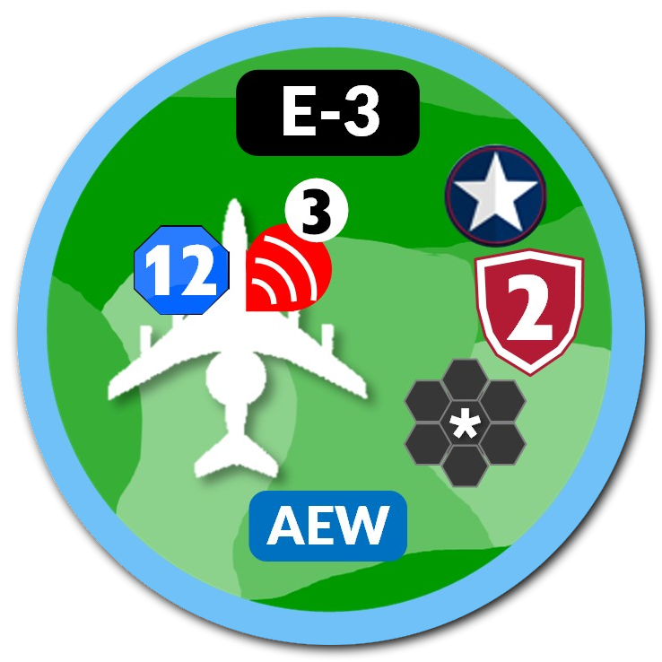

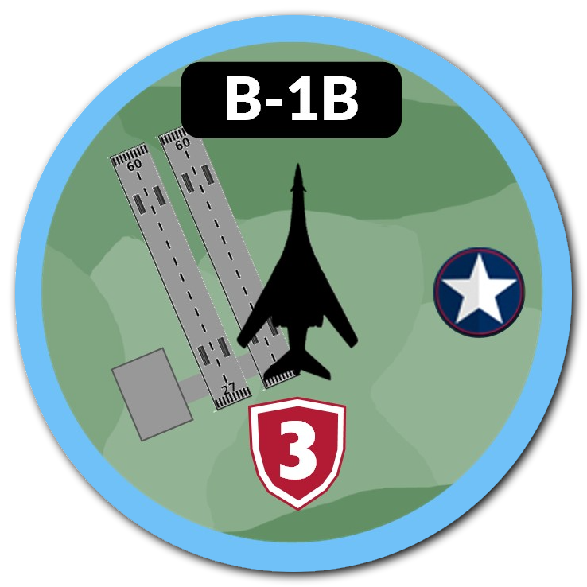
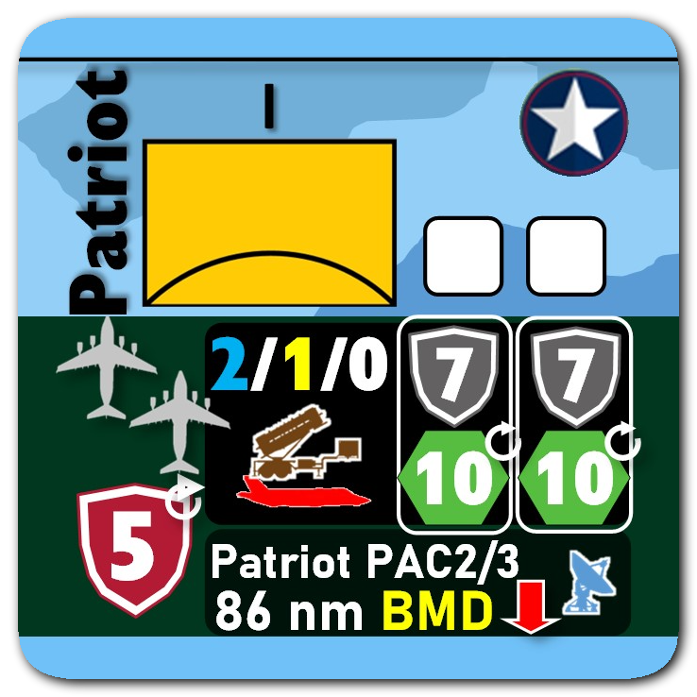
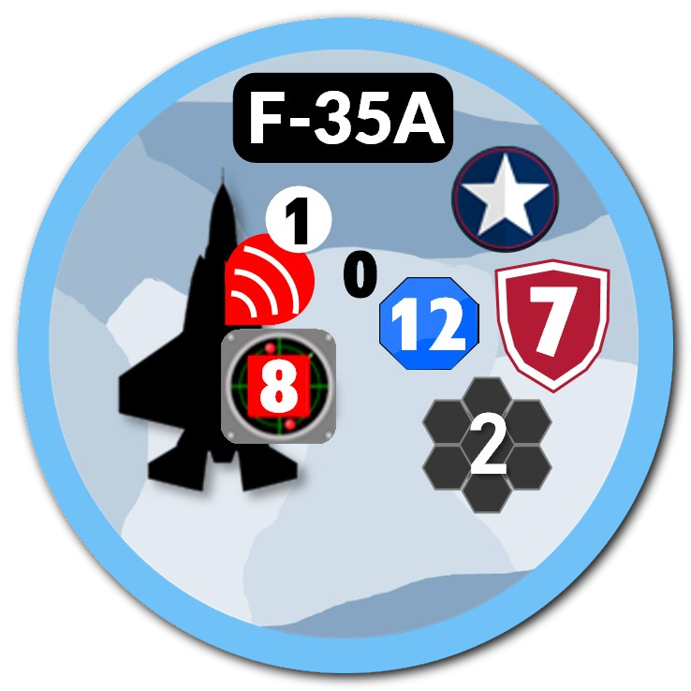
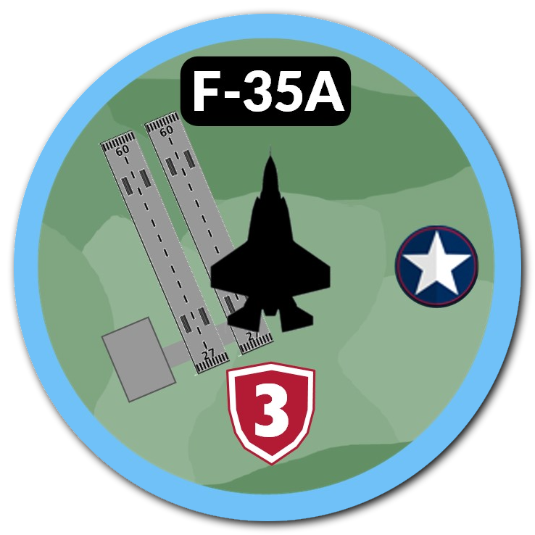
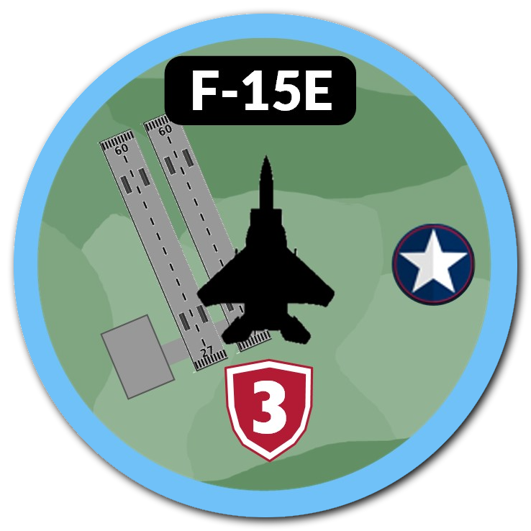
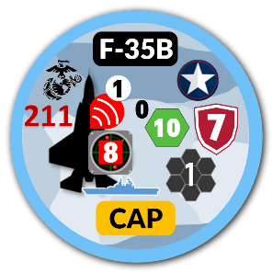
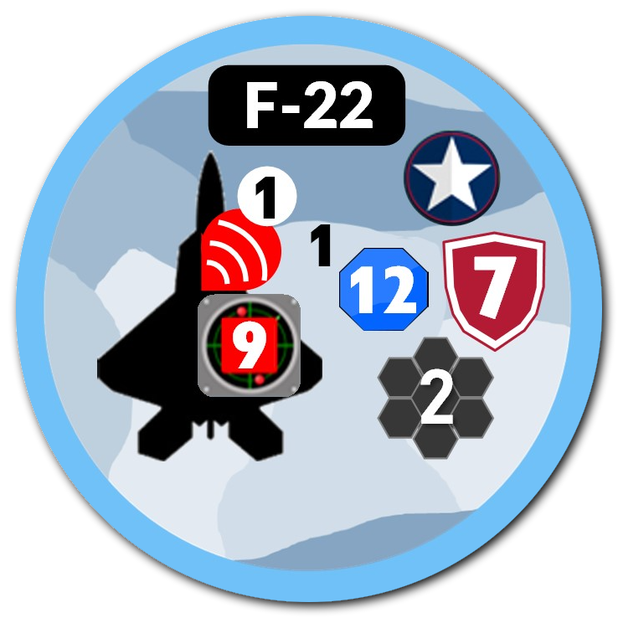
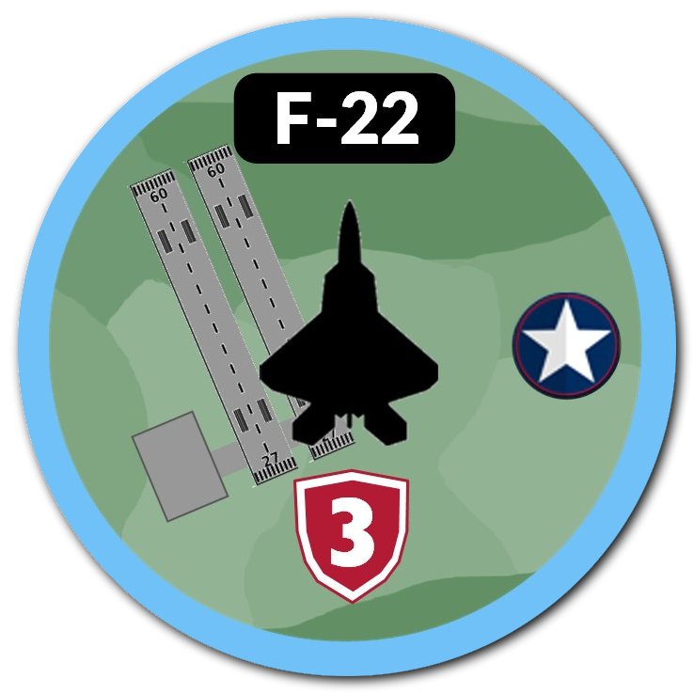
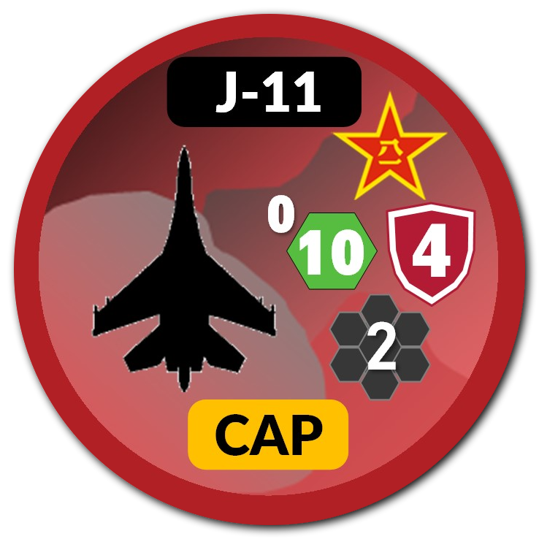
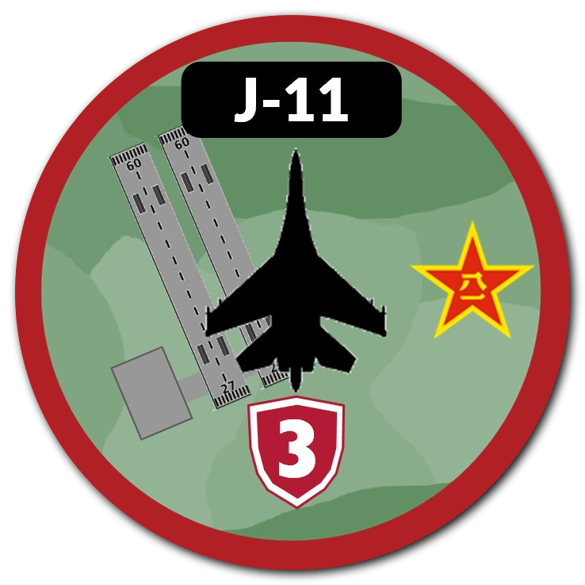
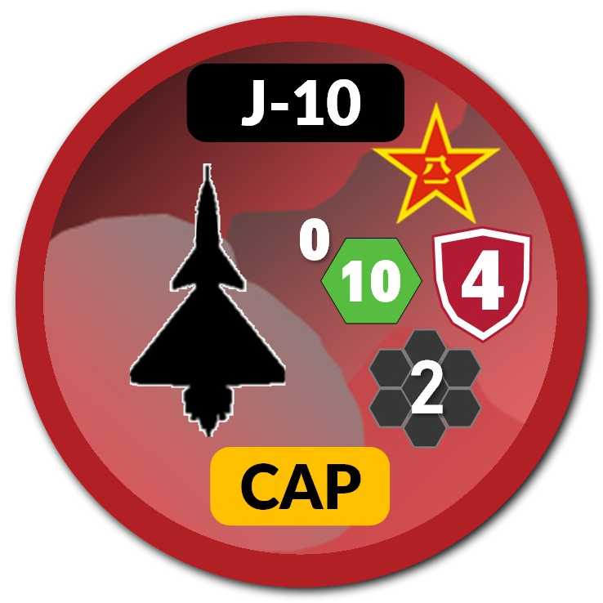
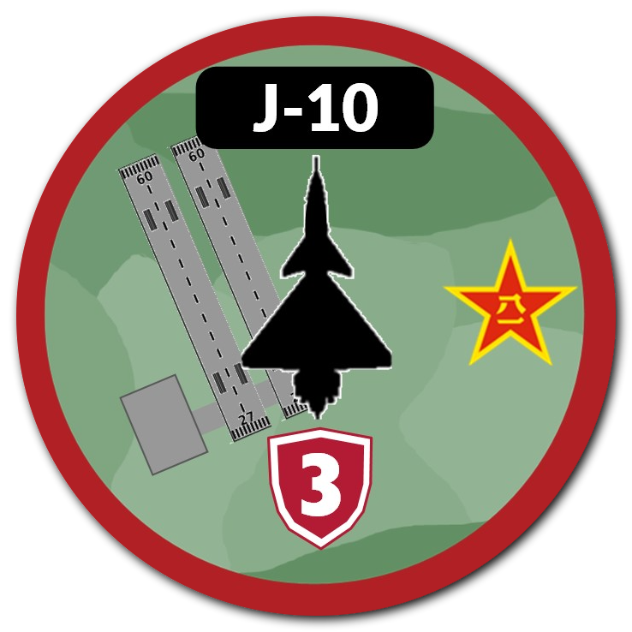
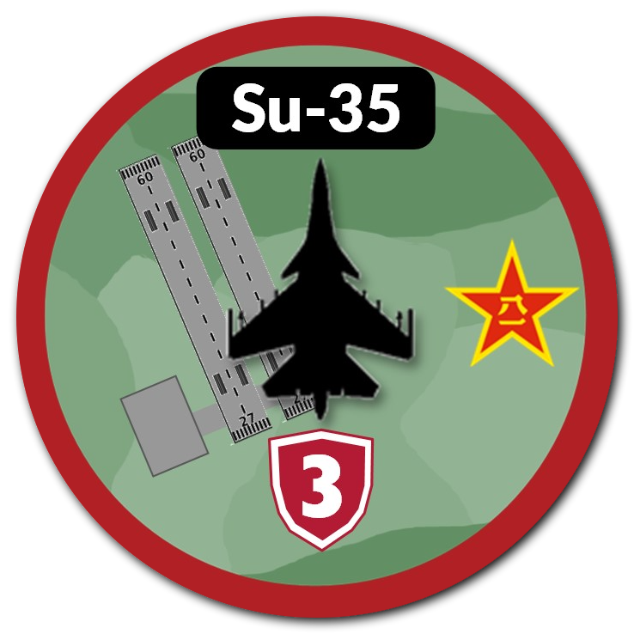
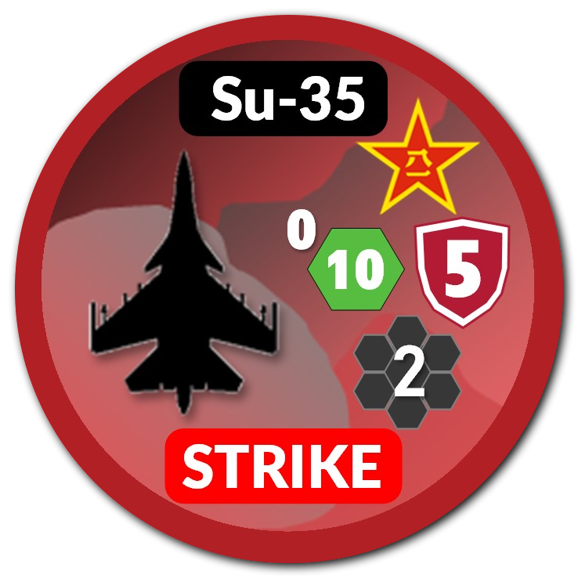
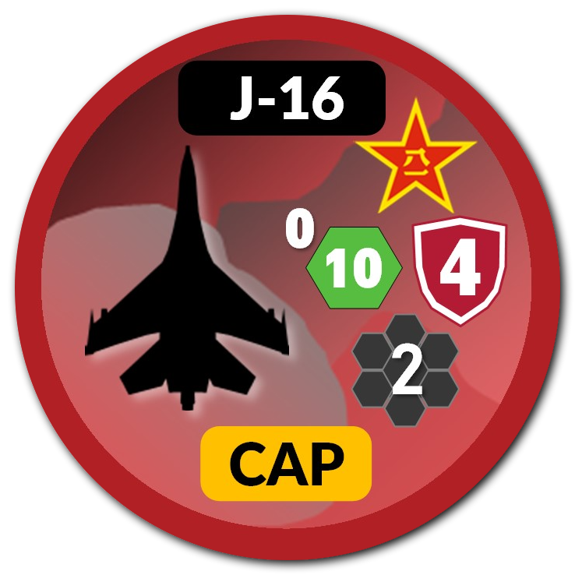
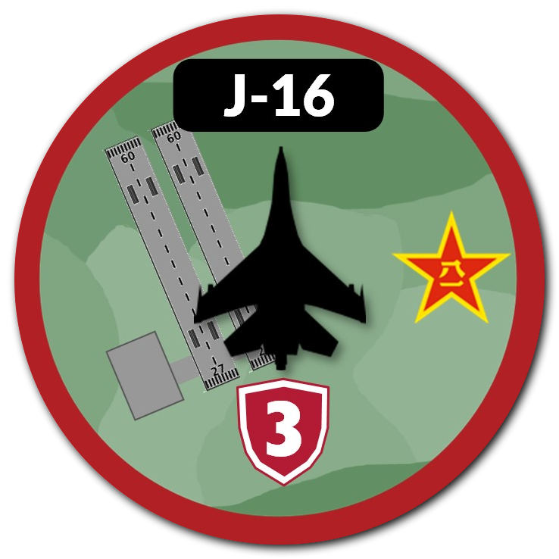
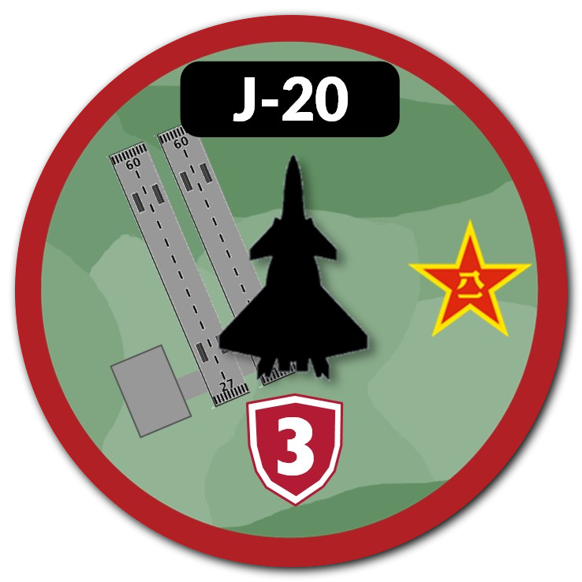

ORDER OR BATTLE
Set up the map as depicted on this slide. (Zoom in to see specific units)
NOTES:
The B-1 and E-3 are considered based Off-Map. They have no combat radius limitations. Therefore, players can place them wherever they might like to achieve the desired effect.
JASSM-ER and B-1 are assumed to be collocated at the same base and, therefore, available for use by the B-1
RED and BLUE may task each fighter unit in whatever mission role they desire for mission accomplishment. For example, RED can elect to attempt strikes on BLUE bases, if player determines strikes align with their objectives.
ADD’L BLUE ASSETS
Can be used by F-15EX and is stored at LAHAD DATU Airbase

Slide 4
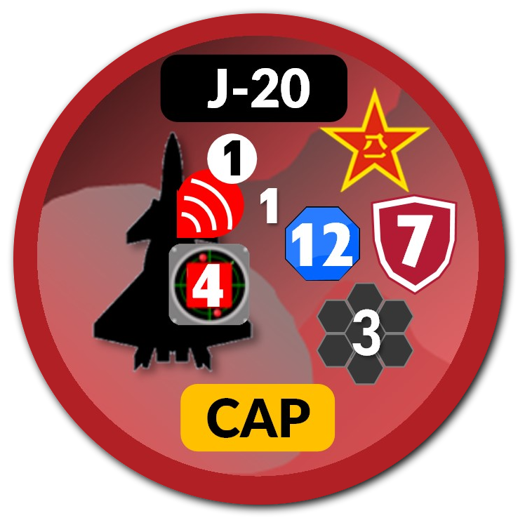

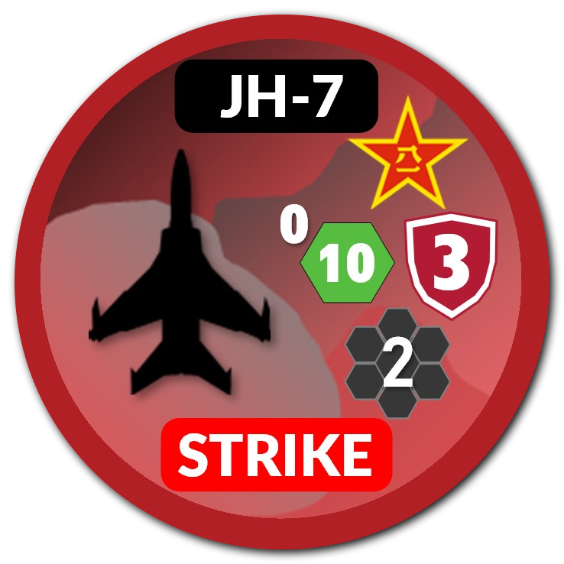
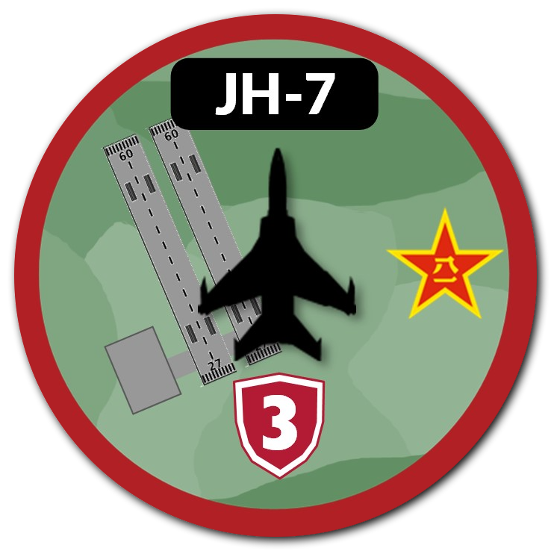
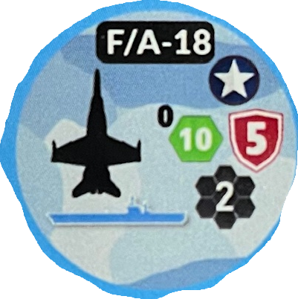
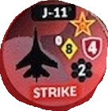
Objectives within 2 game turns
RED
Defend the Spratly Islands from BLUE attack
Total Victory = No Losses to RED weapon’s storage.
Partial Victory = NMT 1 weapon’s cache destroyed.
RED stand-off munitions are incompatible with RED fighter units and may not me used in this scenario.
BLUE
Gain Air Superiority
Destroy RED cruise missile caches
Total Victory = All 3 weapons caches destroyed
Partial Victory = 2 weapons caches destroyed
2 Game Turns
ADD’L BLUE ASSETS
Can be used by F-15EX and is stored at LAHAD DATU Airbase
8
8
8

Slide 5
Objectives within 3 game turns
RED
Defend the Spratly Islands from BLUE attack
Total Victory = No Losses to RED weapon’s storage.
Partial Victory = NMT 1 weapon’s cache destroyed.
RED stand-off munitions are incompatible with RED fighter units and may not me used in this scenario.
BLUE
Gain Air Superiority
Destroy RED cruise missile caches
Total Victory = All 3 weapons caches destroyed
Partial Victory = 2 weapons caches destroyed
3 Game Turns
ADD’L BLUE ASSETS
Can be used by F-15EX and is stored at LAHAD DATU Airbase
8
8
8

Slide 6
Clarification on Fighter out-of-hex detection
Fighter Unit Detection into adjacent Hex is limited by its radar being oriented forward.
In this example the J-20 must declare where its search is oriented. This orientation determines which aircraft it can attempt Out-of-Hex detection against.
8
8
8
8

Slide 7
ADD’L BLUE ASSETS
Can be used by F-15EX and is stored at LAHAD DATU Airbase
8
8
8
This map can be used for mission planning / Players may use the ‘Draw’ function to plot movement, mission roles, and JASSM routing. Download. Do not update here.

Slide 8
D1
D2
D3
D4
D5
C1
C2
C3
C4
C5
8
8
B1
B2
B3
B4
B5
A1
A2
A3
A4
A5

Slide 9
8
8

